Slide 1
Testing Out Project
By:
Oliver J Spryn

Slide 2
Navigating through Basic Programs
In this tutorial I will discuss how to:
Navigate through a few of BlackBoard’s Features.
Use Elluminate for live sessions.
Use Elluminate for recorded sessions.
Use the On-Line School.

Slide 3

BlackBoard’s Features
I will discuss how to access and use the following in BlackBoard:
The Community tab.
The Discussion Board.
The Digital Dropbox.
The Assignments Page.
The Recorded Elluminate Sessions.

Slide 4
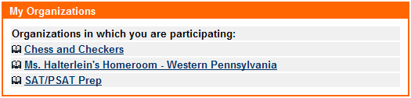
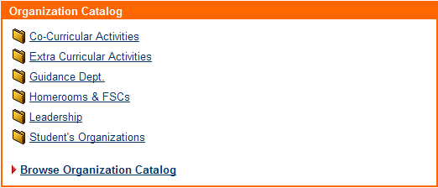
Accessing the Community Tab
1
Once you log into your account in Blackboard, the community tab is located in the upper right corner of the screen (1.) You may select the tab, and the community page will open.
The new page will display “My Organizations”(2) and “Organization Catalog” (3) content windows, as well as few other content windows that may change from time to time.
2
3
Note: The “My Organizations” content window is also available under the “My PAVCS” and “The My Courses” tab.

Slide 5
Using the Community Tab
Clicking on a link under the “My Organizations” window, will bring you to another organization. (1)
To enroll for an
organization that you are not currently participating in, click on the desired category under
“Organization Catalog.” (2)
You may then find the
course you would like to
participate in, and then
click “Enroll.” (3)
To view see the course
home page, click the link in
blue under “Organization
ID.” (See below.)
The organization you signed
up for should appear under
the “My Organizations” in
a short period of time.
1
2
3

Slide 6
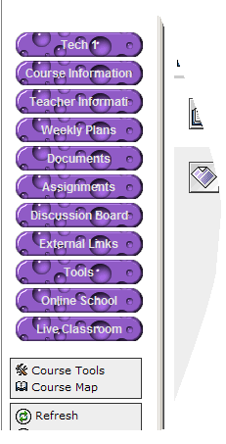
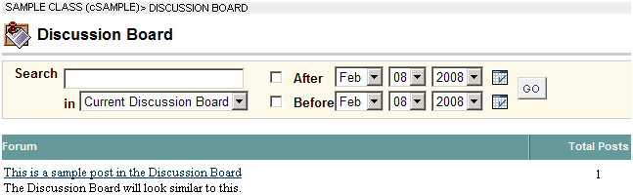
Accessing the Discussion Board
1
In order to access the discussion board, click on a course link, as shown on the right. (1)
Click on “Discussion Board,” on the far left of the screen. (2)
The discussion board will show. (3)
2
3
Note: Your course tray may look different depending on you course theme, and the by the layout you have selected.

Slide 7
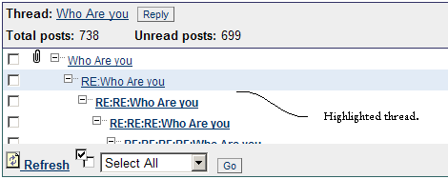
Using the Discussion Board
Click on a forum in the Discussion Board. (1)
Sometimes there will be a sub category in a forum. (2)
Once you are in your sub category, you may respond to any posted thread, by clicking on the thread then clicking “Reply” (3,) and typing you your response.
The threads are usually ordered by date/time.
1
2
3

Slide 8

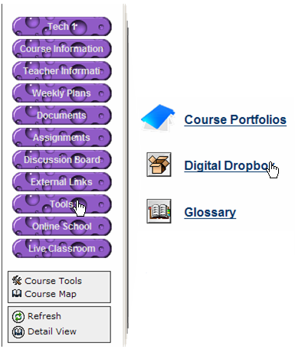
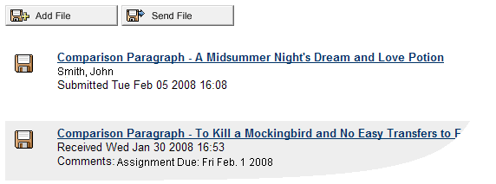
Accessing the Digital Dropbox
The Digital Dropbox is location in BlackBoard where you can send files, and mass receive them from your instructor.
To access this tool, click on your desired course, and on the tray on the left, click “Tools.” (1)
From there you can click on “Digital Dropbox.” (2) Your screen should will look similar to the one below, depending on what has been posted. (3)
1
2
3

Slide 9

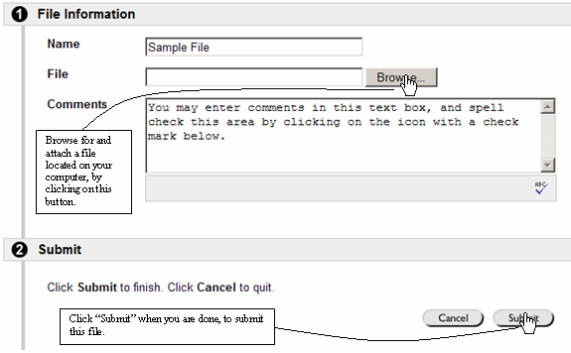
Using the Digital Dropbox
1
To use the Digital Dropbox, click “Add File” or “Send File,” (1) depending on the instructions you received from your instructor.
A new screen will appear, as shown on the right.
You may give the file a name, (2) attach a file located on your computer, (3) and enter and spell-check your comments into a textbox. (4)
Once you click “Submit,” (5) your file will appear in the Digital Dropbox.
2
3
4
5
Note: When you add a file to the Digital Dropbox, you will be able to remove it. When you send a file, it will cannot be removed, and it will be send to the selected people in the course, as directed by the instructor.

Slide 10
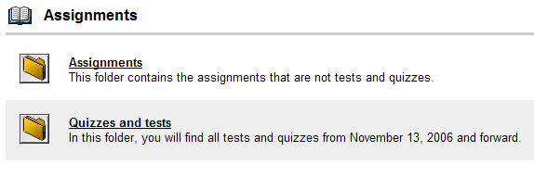
Accessing the Assignments Page
1
Click on a course you in which you wish to access the assignments. (1)
Then click on the “Assignments” button on the left side bar. (2)
The Assignments page will display. (3)
2
3

Slide 11
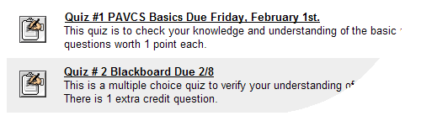
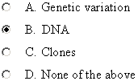


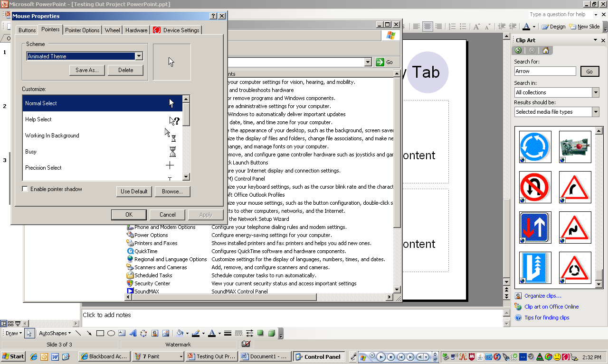
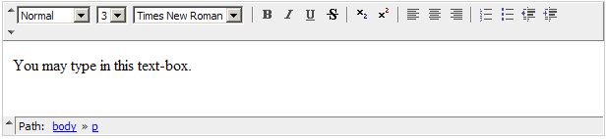

Using the Assignments Page
You may then click on an assignment to begin the process. (1)
Once you enter the assignment, there are five different ways to enter your answers.
Depending on how the assignment is designed you may answer using: Multiple choice, matching, fill in the blank or jumbled sentence, and/or short answer. (2)
You may periodically save your work, by clicking the “Save” (3) button.
Click “Submit” (4) to turn in the assignment.
1
Multiple Choice
Matching
Fill in the Blank/Jumbled Sentence
2
Short Answer
3
4

Slide 12

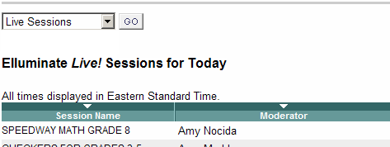
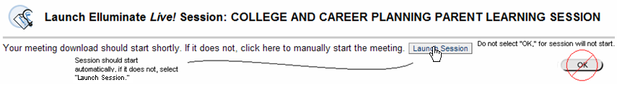
Accessing the Live Elluminate Sessions
1
Select any course to access recorded Elluminate Sessions. (1)
On the left menu bar, select, “Live Classroom,” “Elluminate,” “Class,” or “Communications” (2.) If you must select “Communications” you must also select “Elluminate Live” when the new link appears. Different courses may have different ways of entering an Elluminate room.
The Live Elluminate sessions will display.
You may enter a live session by clicking on a link in blue. (3)
Elluminate will start, and your name will be automatically filled in. (4)
Public Elluminate sessions are also available under the Elluminate tab in the top right of the BlackBoard page.
2
3
4

Slide 13
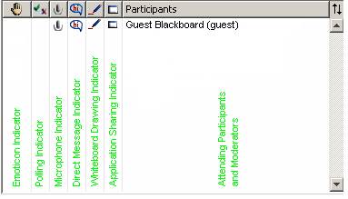
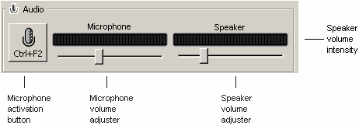
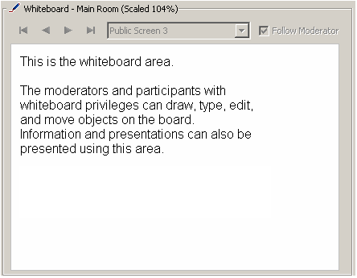
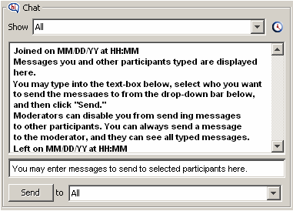
Using Elluminate for Live Sessions

Slide 14

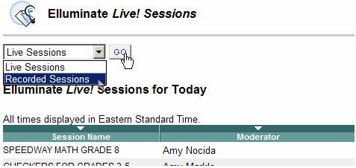
Accessing the Recorded Elluminate Sessions.
1
Select any course to access recorded Elluminate Sessions. (1)
On the left menu bar, select, “Live Classroom,” “Elluminate,” “Class,” or “Communications” (2.) If you must select “Communications” you must also select “Elluminate Live” when the new link appears. Different courses may have different ways of entering an Elluminate room.
The Live Elluminate sessions will display.
Select the drop-down bar, and press “Recorded Sessions,” (3) and then press “Go.” (4)
The recorded Elluminate Sessions will display.
4
3
2
Note: Recorded Elluminate session can also be found under the Elluminate tab, at the top right corner of the screen. Click on the “more” link at the bottom of the new screen, and then only public sessions will display. Then follow the last two steps listed above.

Slide 15
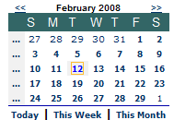

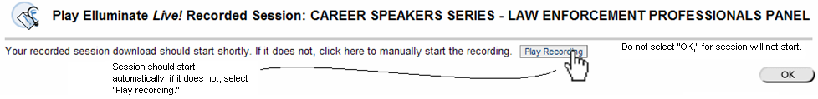


Accessing the Recorded Elluminate Sessions
You may find your Elluminate Session by selecting BlackBoard to display the session one day, week, or month at a time. (1)
Once you find the session would like, you my click on the blue text. (2)
Elluminate will start and session will download. (3 and 4)
1
2
3
4

Slide 16
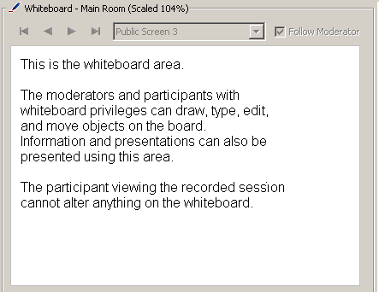
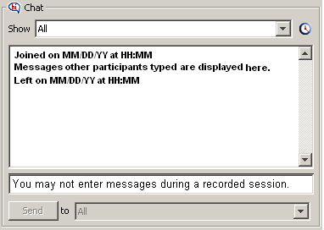
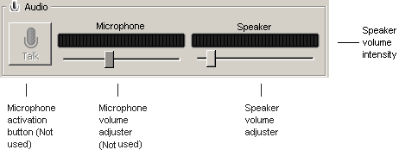
Using Elluminate for Recorded Sessions
A: Move to the previous recorded section.
B: Stop playing recording.
C: Play recording; automatically begins at startup.
D: Pause playing recording.
E: Fast-forward the recording.
F: Move to the next recorded section.
G: Select a section of recording to move to.
H: Amount of time recording has played.
I: Downloaded recording
J: Buffering recording; only shows when you drag slider ahead.
K: Slider, where recording is playing; can be slid forward or backward.
L: Section downloaded, but not yet played
M: Section not downloaded.

Slide 17
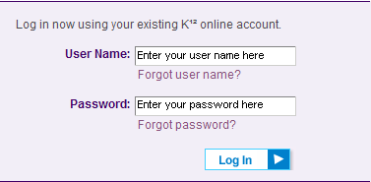




Accessing the On-Line School (OLS)
The On-Line School is a used for reading material by PAVCS.
In order to access this material, you may log into the OLS (1), and then press the button that says “Students” (2.)
Then, you may select your name from the list of students. (3) Then select “High School” (4.)
A new window will then show. After reading the content, you may select “I understand” (5.)
A the link will open in a new window or tab, and it will show the page labeled “My School.” Up near the K12 logo (see below) you will see a navigation bar. Select “My courses” (6)
The On-Line School reading material courses will display.
1
3
2
4
5
6

Slide 18
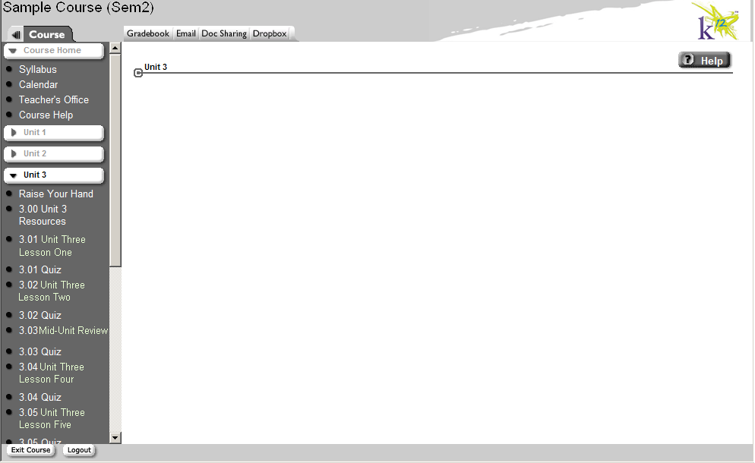

Using the On-Line School
Once you select course to read, a page much like this one will display.
You may select a unit (1) and then a lesson (2) to read.
The lesson will load, and you may navigate through lesson by using the left and right tabs at the bottom of the screen (3.) You may also enter the page number in the text-box and press “enter,” to skip directly to a page (4.)
To exit the course, you my press “exit course,” at the bottom –left of the window (5.)
1
2
5
3
4

